Slide 1

Welcome to the World of Data Science
QMGT-4750-01 / QMGT-677-01:
Collecting and Analyzing Data Using R

Slide 2
From data to information…
Data science is at the intersection of programming and analysis
Programming can solve many problems, including “data wrangling.”
Importing Data
Cleaning Data
Transforming Data
Data science is more than importing, cleaning, and transforming data. Data scientists also understand the data and how to extract useful information from the data.

Slide 3
Data scientists change data into information.

Slide 4
From data to information…
To move from data to information, the data needs to be in a format that allows data to be analyzed statistically.
Amazon stock prices for a week…
date | open | high | low | close | log close | volume
5/19/1997 | 1.7083 | 1.7708 | 1.625 | 1.7083 | 0.232564141 | 6106800
5/20/1997 | 1.7292 | 1.75 | 1.6358 | 1.6358 | 0.213730204 | 5467200
5/21/1997 | 1.6042 | 1.6458 | 1.375 | 1.4275 | 0.154576117 | 18853200
5/22/1997 | 1.4375 | 1.4483 | 1.3125 | 1.3958 | 0.144823194 | 11776800
5/23/1997 | 1.4067 | 1.5208 | 1.3333 | 1.5 | 0.176091259 | 15937200

Slide 5
From data to information…
But it’s rarely that straightforward.
Most often, it’s
Formatted in way we can’t use it
Unformatted
Incomplete

Slide 6
From data to information…
Even when formatted, it can come from a variety sources.
Simple text files, such as CSV, DAT, or TXT
Structured text files, such as XML
Proprietary files, such as SPSS or SAS
Relational databases, such as SQL
Non-Relational databases, such as CouchDB
Embedded data, such as HTML

Slide 7
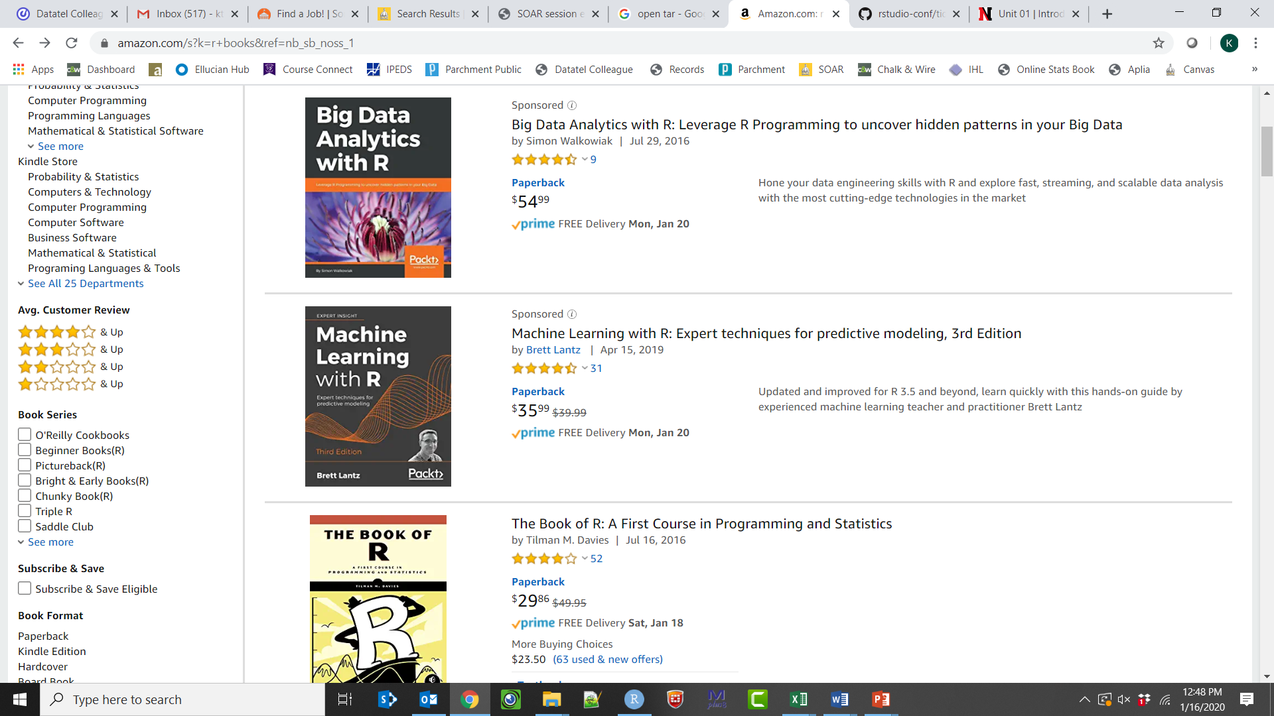
From data to information…
Data embedded on webpages can be “scraped”

Slide 8
R is a powerful tool when turning data into information.

Slide 9
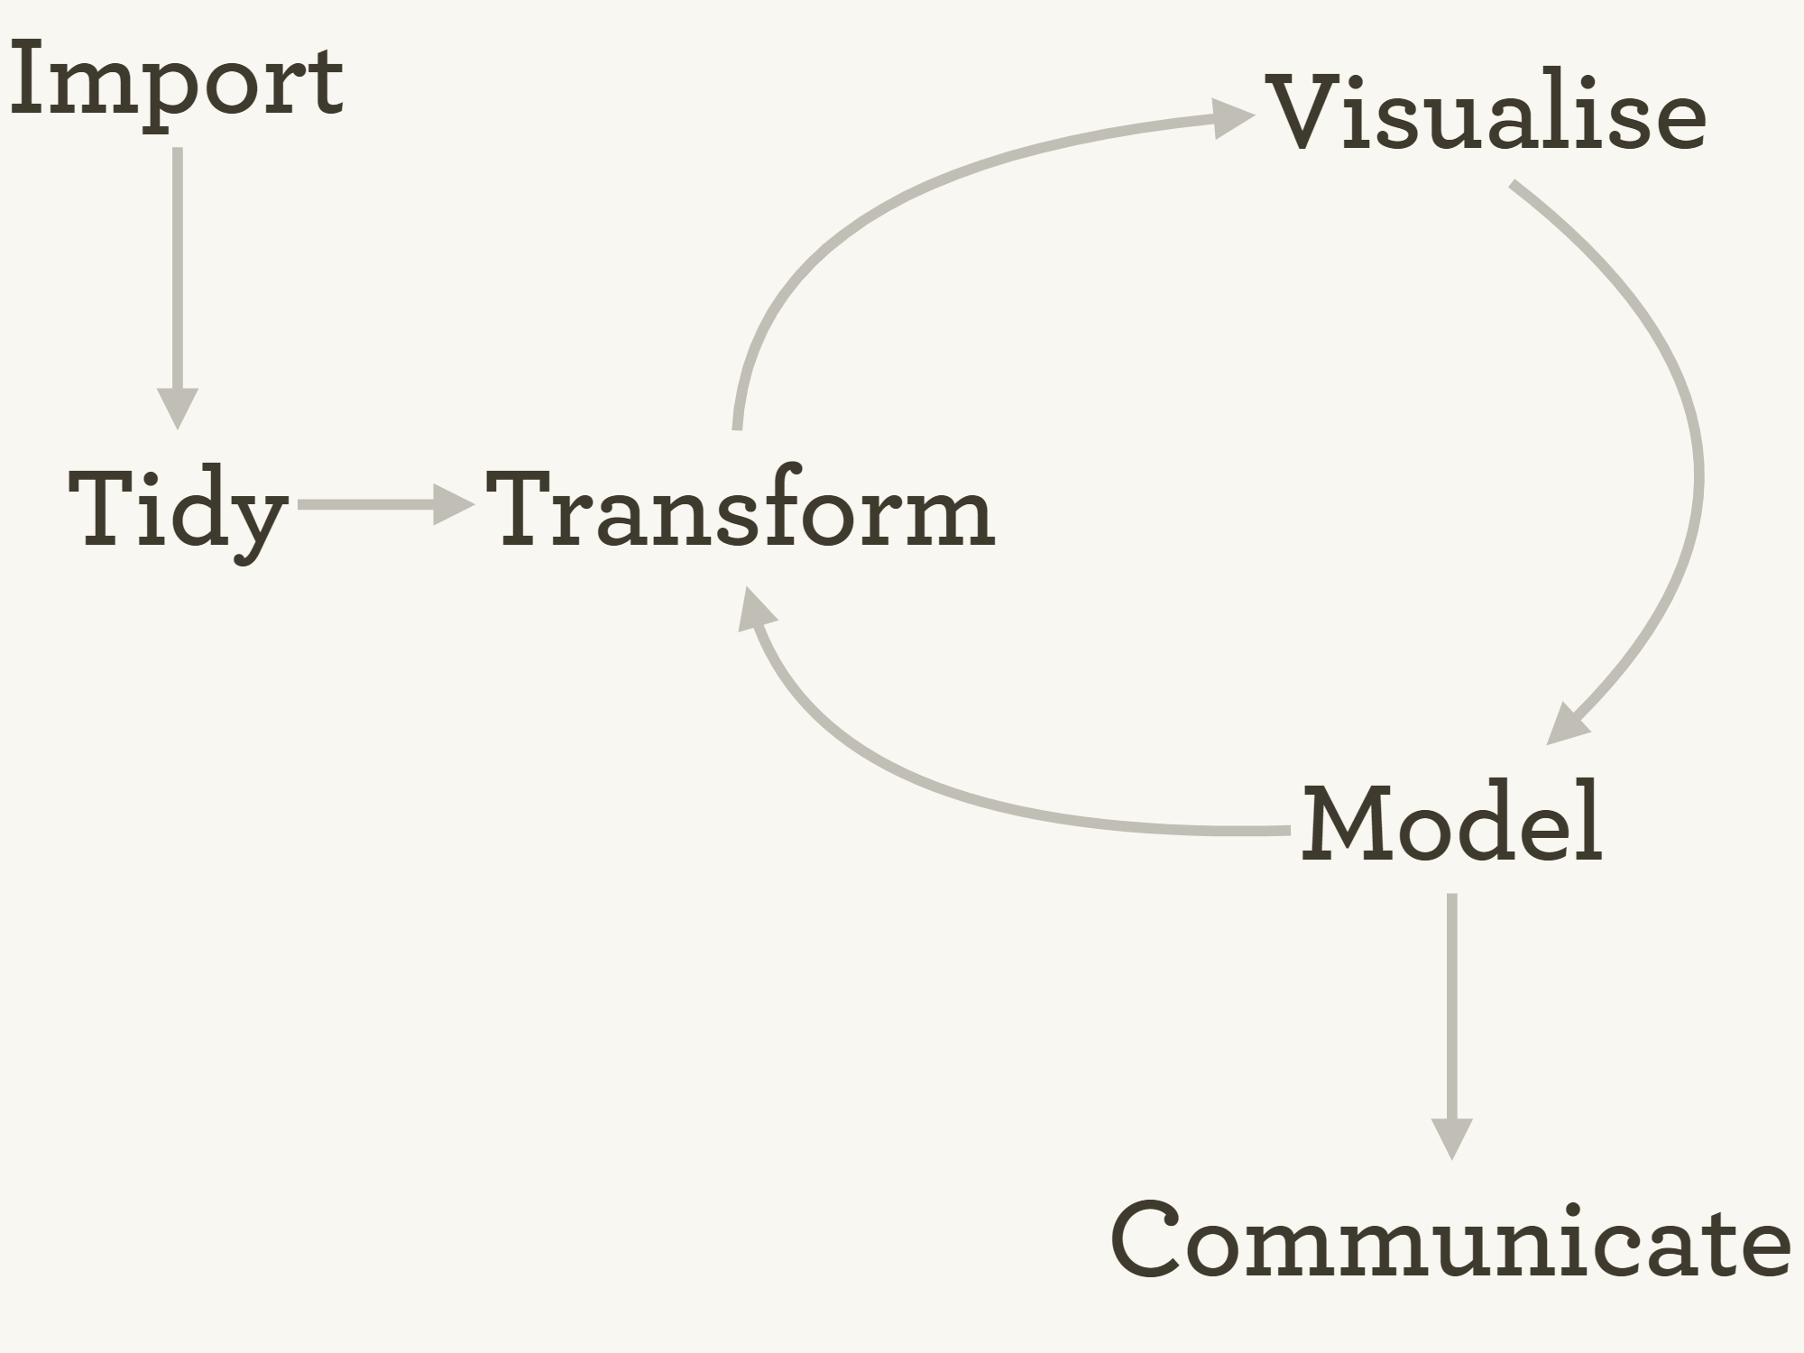
https://github.com/rstudio/rstudio-conf/blob/master/2017/The_Tidyverse-Hadley_Wickham/tidyverse.pdf

Slide 10
From data to information…
Remember, data scientists change data into meaningful information.
Can be challenging – data can be in various forms and come from various sources.
We will examine the challenges and tools/methods (in R) for addressing those challenges.

Slide 11
Welcome to the World of Big Data
As technology matures and resources become more affordable, data sets are becoming bigger and bigger.
Big data refers to “data that is so large, fast or complex that it’s difficult or impossible to process using traditional methods.”
https://www.sas.com/en_us/insights/big-data/what-is-big-data.html#history
A sample-size of 1000 of human genome data can be around 80 terabytes (~81,920 GB).
Big data provides more robust analysis, but moves analysis beyond traditional approaches and into multiple dimensions.

Slide 12
Welcome to the World of Big Data
In 2020, there will be around 40 trillion gigabytes of data (40 zettabytes). (Source: EMC)
90% of all data has been created in the last two years. (Source: IBM)
Today it would take a person approximately 181 million years to download all the data from the internet. (Source: Physics.org)
In 2012, only 0.5% of all data was analyzed. (Source: The Guardian)
Internet users generate about 2.5 quintillion bytes of data each day. (Source: Data Never Sleeps 5.0)
97.2% of organizations are investing in big data and AI. (Source: New Vantage)
In 2020, the big data market is expected to grow by 14%. (Source: Statista)
Job listings for data science and analytics will reach around 2.7 million by 2020. (Source: Forbes)
By 2020, every person will generate 1.7 megabytes in just a second. (Source: Domo)
As of January 2020 there were over 1.74 billion websites on the Internet. (Source: websitehosting.com)

Slide 13
The Vs of Big Data (Doug Laney)
Volume
Organizations collect data from a variety of sources, including business transactions, smart devices, industrial equipment, videos, social media and more. In the past, storing it would have been a problem – but cheaper storage on platforms like data lakes and Hadoop have eased the burden.

Slide 14
The Vs of Big Data (Doug Laney)
Velocity
With the growth in the Internet of Things, data streams in to businesses at an unprecedented speed and must be handled in a timely manner. RFID tags, sensors, and smart meters are driving the need to deal with these torrents of data in near-real time.

Slide 15
The Vs of Big Data (Doug Laney)
Variety
Data comes in all types of formats – from structured, numeric data in traditional databases to unstructured text documents, emails, videos, audios, stock ticker data, and financial transactions.

Slide 16
The Vs of Big Data (SAS)
Variability
In addition to the increasing velocities and varieties of data, data flows are unpredictable – changing often and varying greatly. It’s challenging, but businesses need to know when something is trending in social media, and how to manage daily, seasonal, and event-triggered peak data loads.

Slide 17
The Vs of Big Data (SAS)
Veracity
Veracity refers to the quality of data. Because data comes from so many different sources, it’s difficult to link, match, cleanse, and transform data across systems. Businesses need to connect and correlate relationships, hierarchies, and multiple data linkages. Otherwise, their data can quickly spiral out of control.

Slide 18
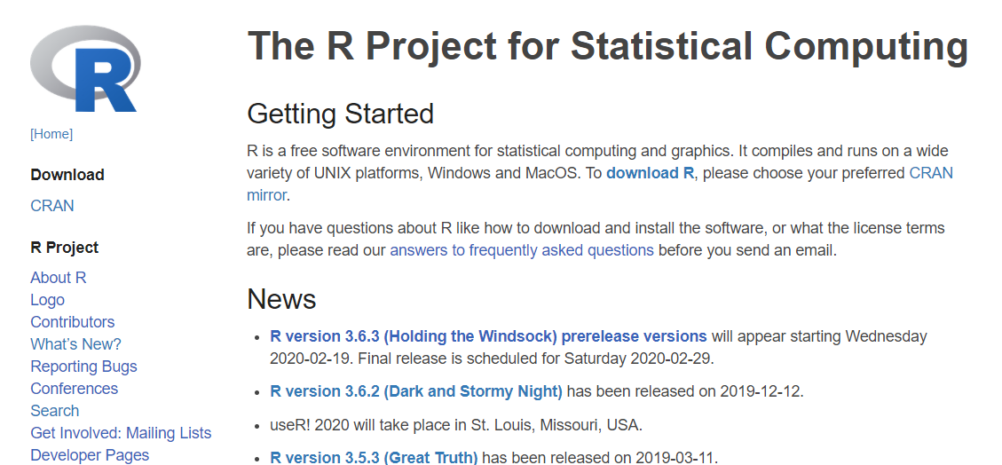
Downloading R
https://www.r-project.org/

Slide 19
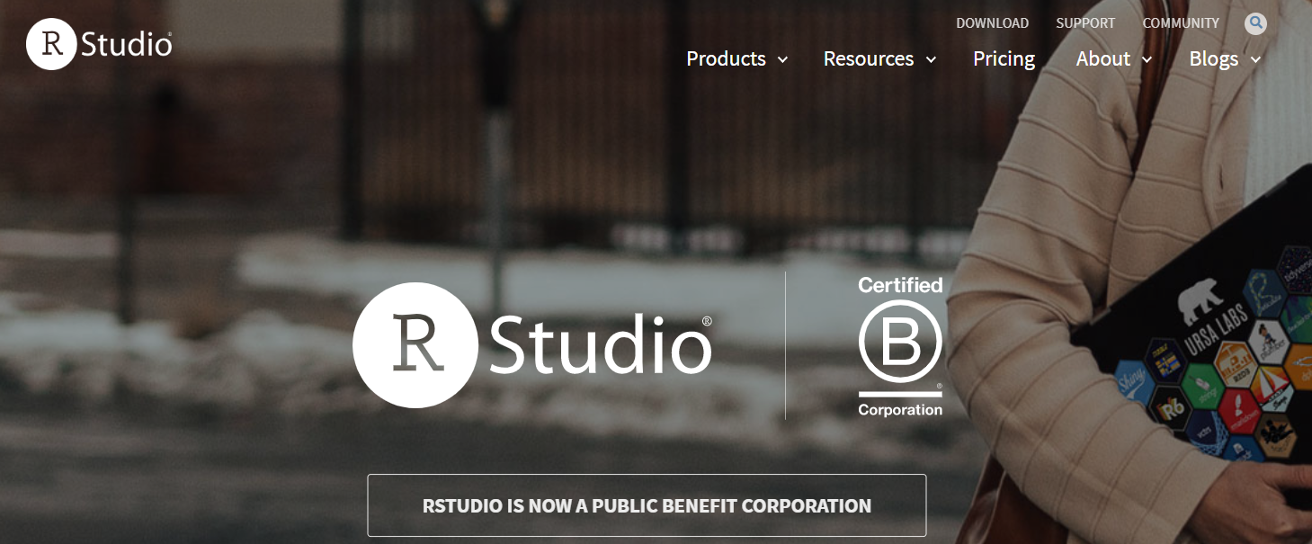
Downloading RStudio
https://rstudio.com/

